Slide 1
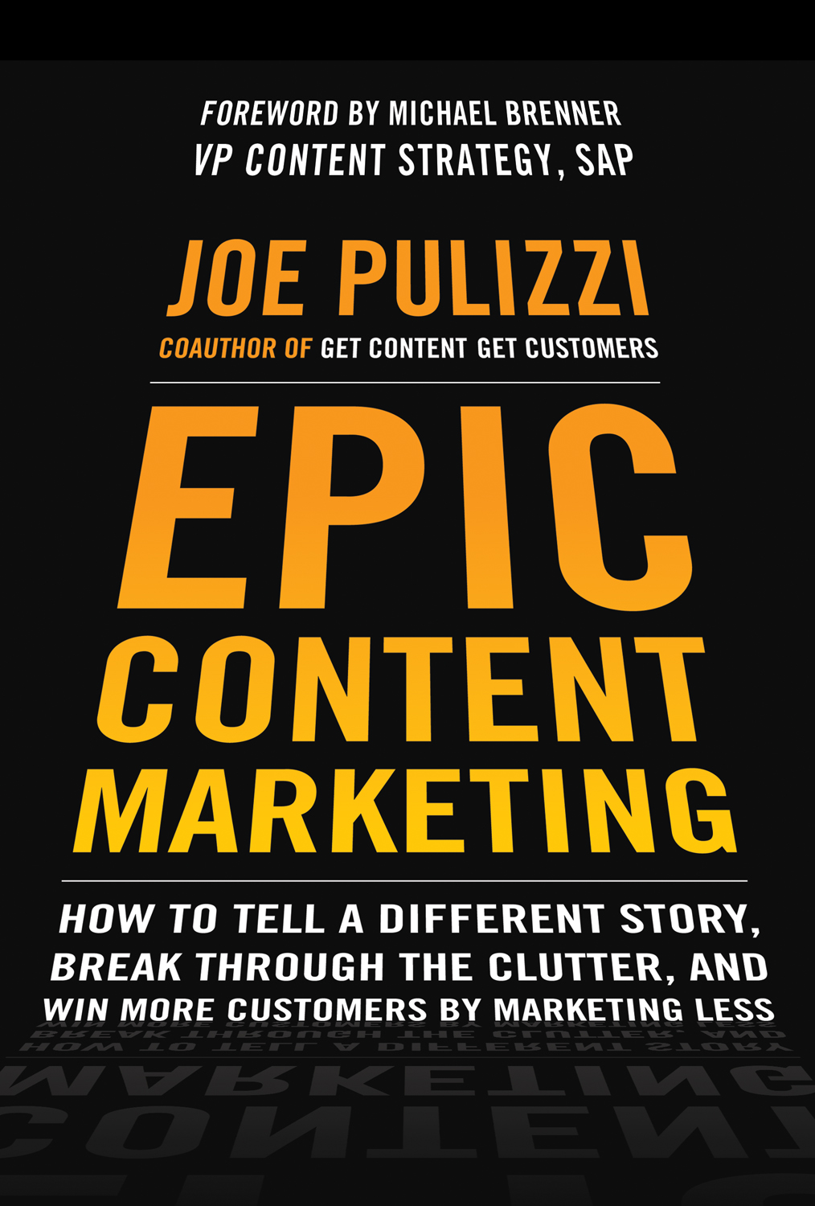
Epic Content Marketing Resolutions @JoePulizzi

Slide 2
Today
A bit of history…
A bit of research…
Tangible Steps to Take with Your Content Marketing for 2014

Slide 3
The ONE Key to a Successful Presentation?

Slide 4
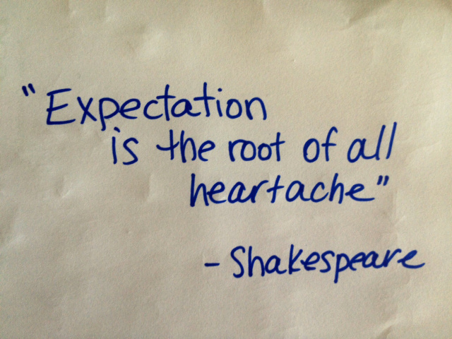
Image courtesy of Pooky Poetry

Slide 5
The Original Content Marketing Program?

Slide 10
HOMEWORK The Most Famous Content Marketing Strategy In the World!

Slide 13
Show Me the Research!

Slide 14
http://bitly.com/cm-research

Slide 15
Just 42% believe their
content marketing is effective

Slide 16
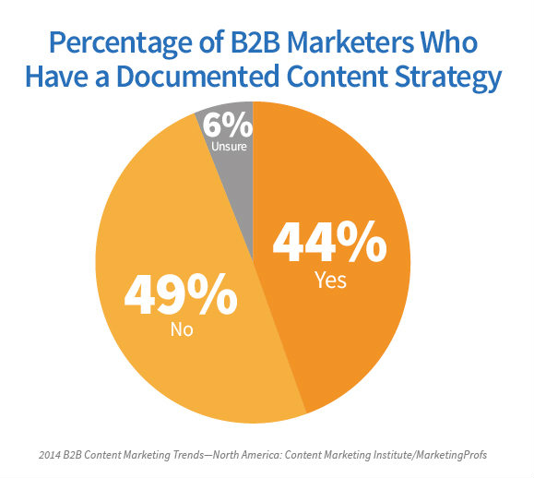
http://bitly.com/cm-research

Slide 17
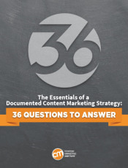
http://bitly.com/cmstrategy

Slide 19
Resolution #1
Fill a Need & Find Your Why
Notes:
And let’s start by discussing how we help buyers make better purchasing decisions. Because before we can truly understand what we do for vendors like you, it’s critical to understand what we do for the buyer community.
₁₉

Slide 20
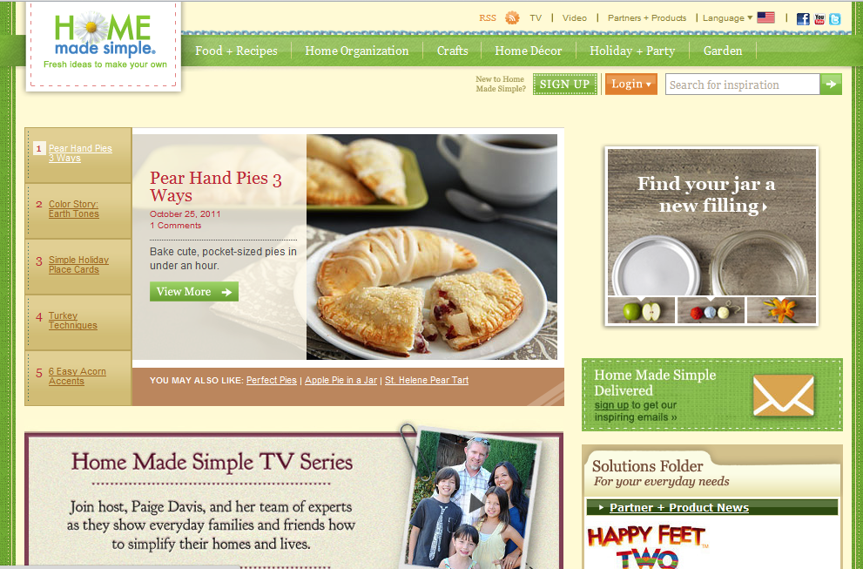

Slide 21
Enabling Women to Have More Quality Time with Their Families

Slide 22
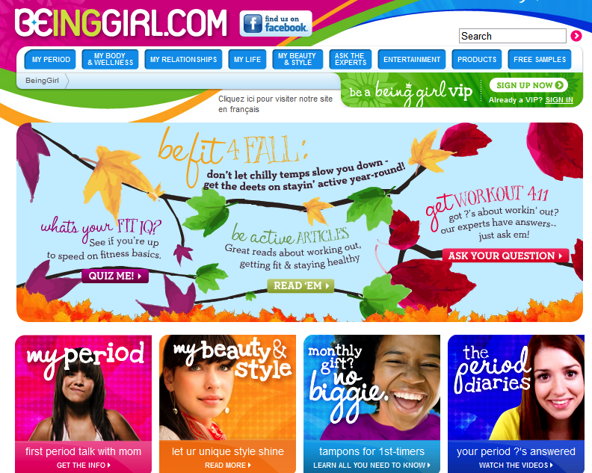

Slide 23
Enabling Teen Girls to
Be More Confident with Their Bodies

Slide 24
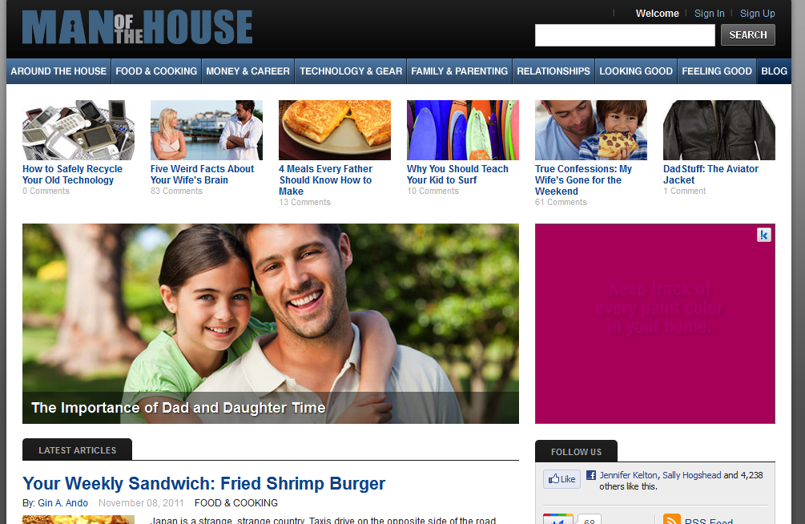

Slide 25
Helping Men Become Better Men

Slide 26
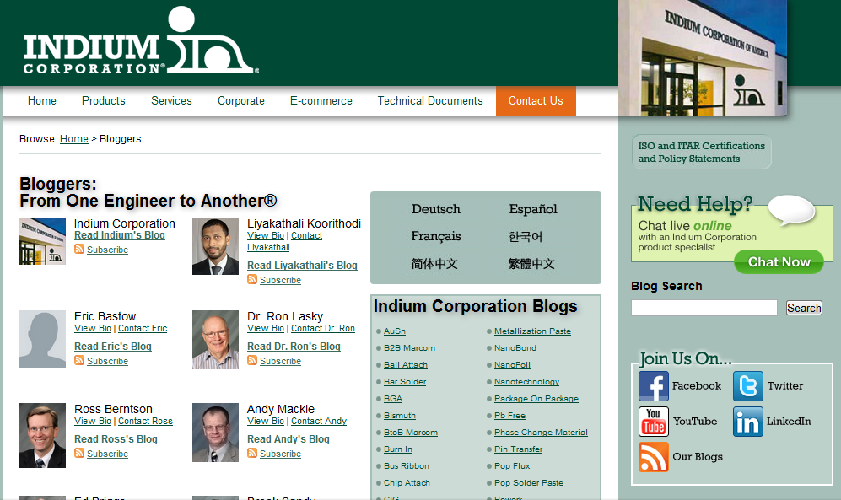

Slide 27
Help Engineers Answer the Most Challenging Industrial Solder Questions

Slide 28
Social Media
Search Engine Optimization
INDIUM CONTENT
Lead Generation

Slide 29
Resolution #2
Create a Content Marketing Mission
Notes:
And let’s start by discussing how we help buyers make better purchasing decisions. Because before we can truly understand what we do for vendors like you, it’s critical to understand what we do for the buyer community.
29

Slide 30
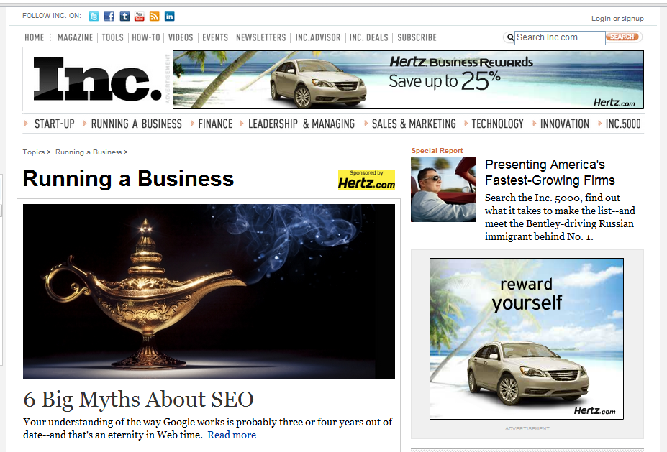
Why?

Slide 31
Why?
Welcome to Inc.com, the place where entrepreneurs and business owners can find useful information, advice, insights, resources and inspiration for running and growing their businesses.

Slide 32
Why?
Welcome to Inc.com, the place where entrepreneurs and business owners can find useful information, advice, insights, resources and inspiration for running and growing their businesses.
Core Target Audience
What Will Be Delivered
The Outcome for the Audience

Slide 33
Resolution #3
Publicly Answer Your Customers Questions
Notes:
And let’s start by discussing how we help buyers make better purchasing decisions. Because before we can truly understand what we do for vendors like you, it’s critical to understand what we do for the buyer community.
33

Slide 34
Marcus Sheridan CEO, River Pools & Spas

Slide 35
2007
$4.5 million in Sales
$250,000 advertising spend

Slide 36
2007
$4.5 million in Sales
$250,000 advertising spend
Sold more fiberglass swimming pools than any other pool retailer in North America.
$40,000 in advertising spend
Won 15% more bids
Cut sales cycle in half.
2011

Slide 37
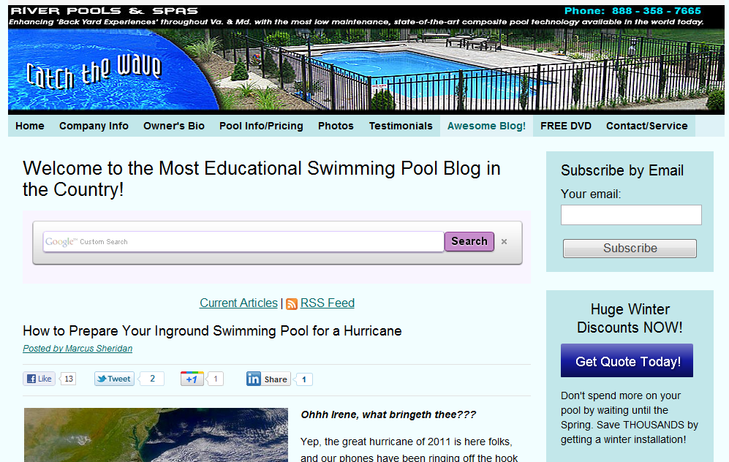

Slide 38
75,000 visits per month

Slide 39
Yep, David vs. Goliath is Real

Slide 41
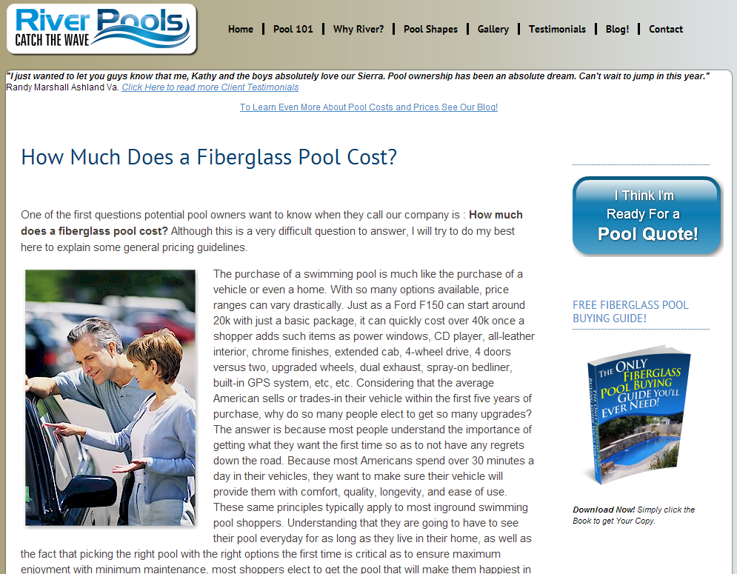

Slide 42
Resolution #4
Subscribers: Build It or Buy It
Notes:
And let’s start by discussing how we help buyers make better purchasing decisions. Because before we can truly understand what we do for vendors like you, it’s critical to understand what we do for the buyer community.
42

Slide 43
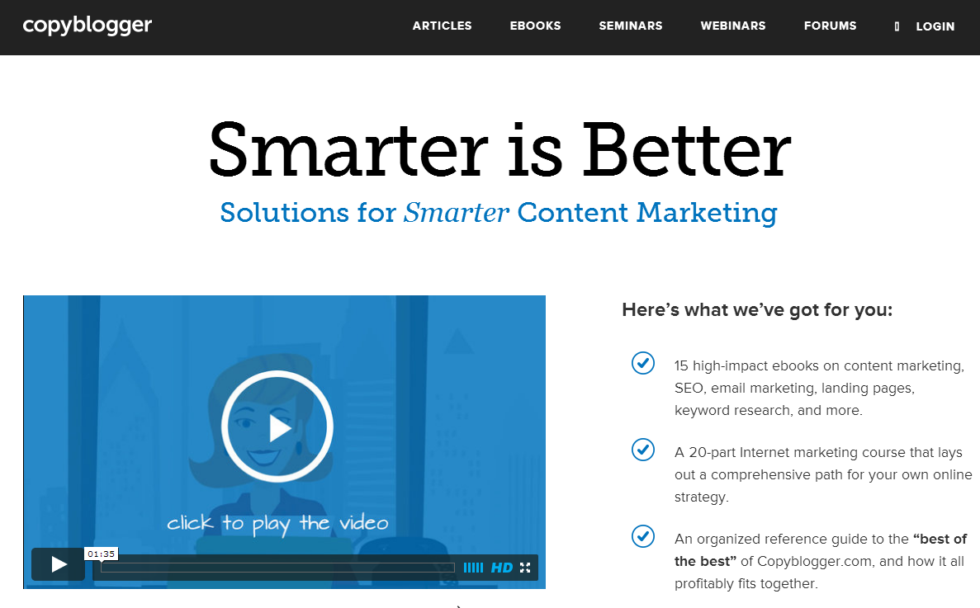

Slide 45
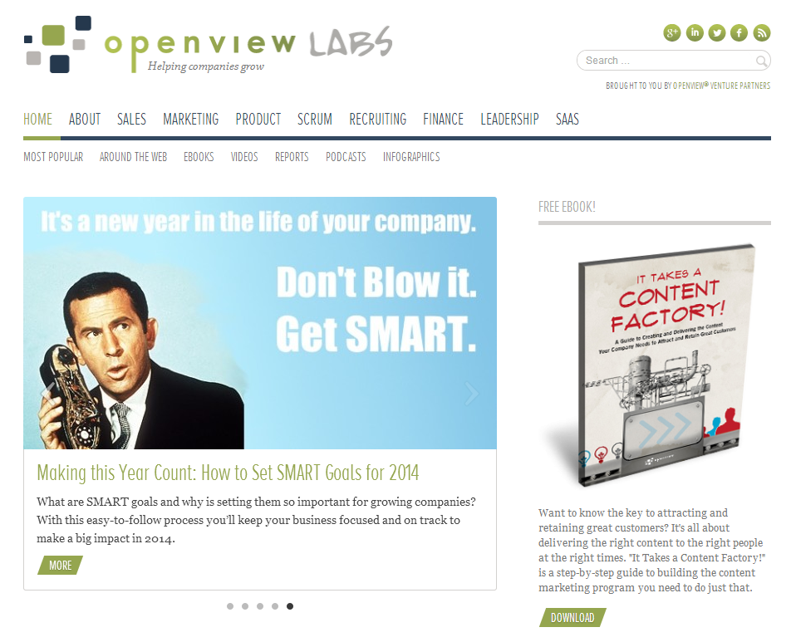

Slide 46
What’s the difference between those who subscribe to my content and those that don’t?

Slide 47
Image courtesy sendgrid.com

Slide 50
HOMEWORK:
Active Community of Subscribers in Your Niche
Notes:
And let’s start by discussing how we help buyers make better purchasing decisions. Because before we can truly understand what we do for vendors like you, it’s critical to understand what we do for the buyer community.
50

Slide 51
Image courtesy of thefutureorganization.com

Slide 52
Building Audience with Influencers
Notes:
And let’s start by discussing how we help buyers make better purchasing decisions. Because before we can truly understand what we do for vendors like you, it’s critical to understand what we do for the buyer community.
52

Slide 54
The Social Media 4-1-1 Plan
Notes:
And let’s start by discussing how we help buyers make better purchasing decisions. Because before we can truly understand what we do for vendors like you, it’s critical to understand what we do for the buyer community.
54

Slide 55
Influencer Sharing
Sales
4 - 1 - 1
Content Marketing

Slide 58
http://bitly.com/cmnative

Slide 59
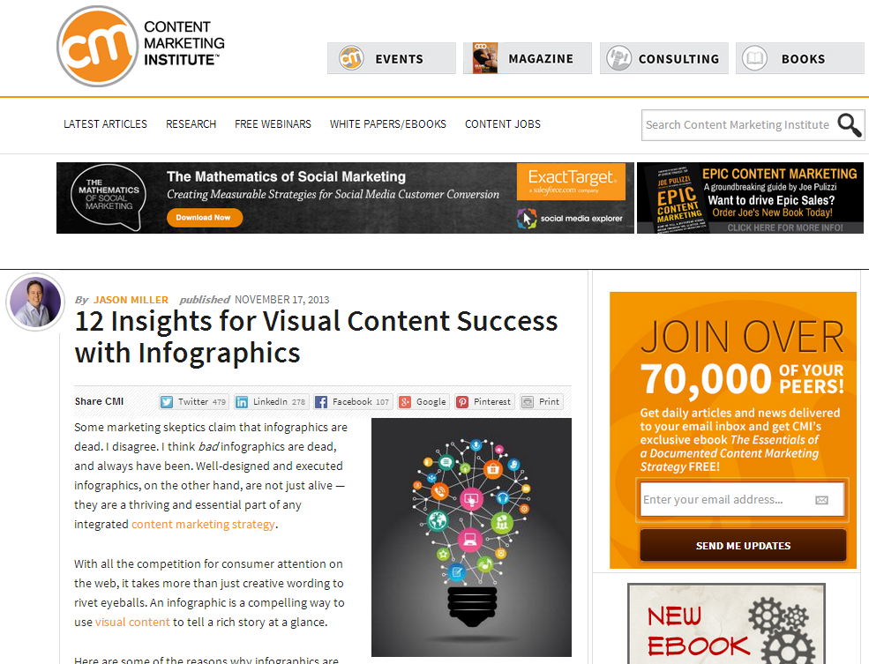

Slide 61
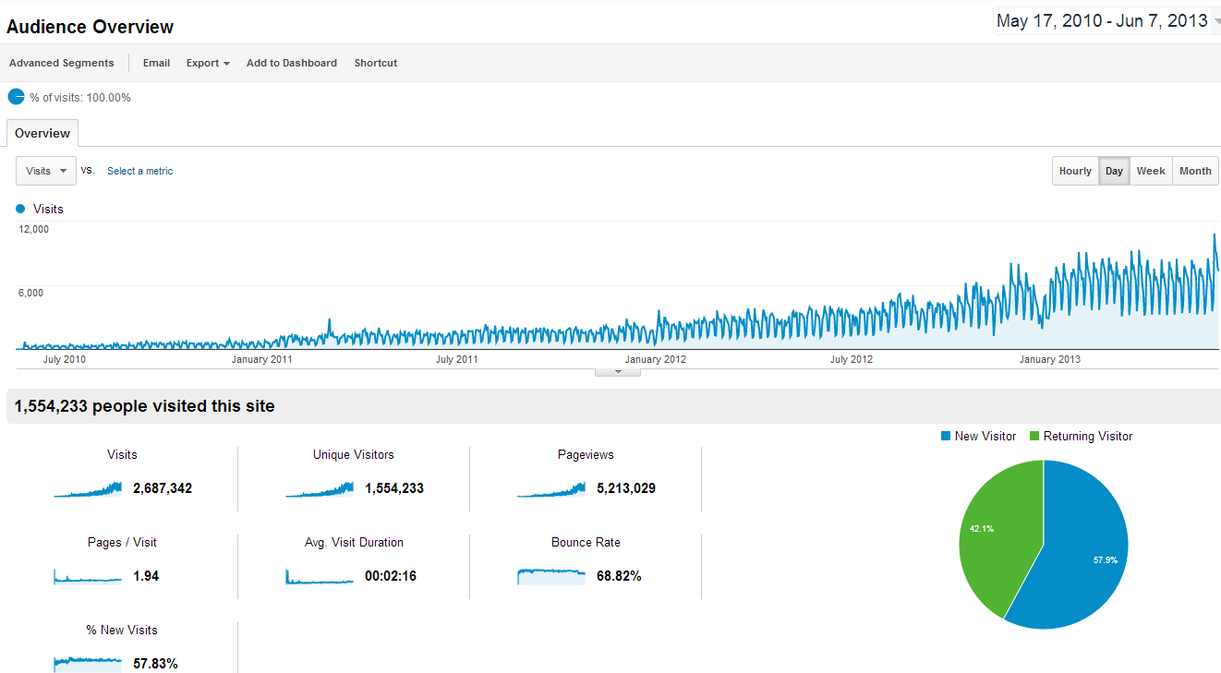
80%

Slide 63
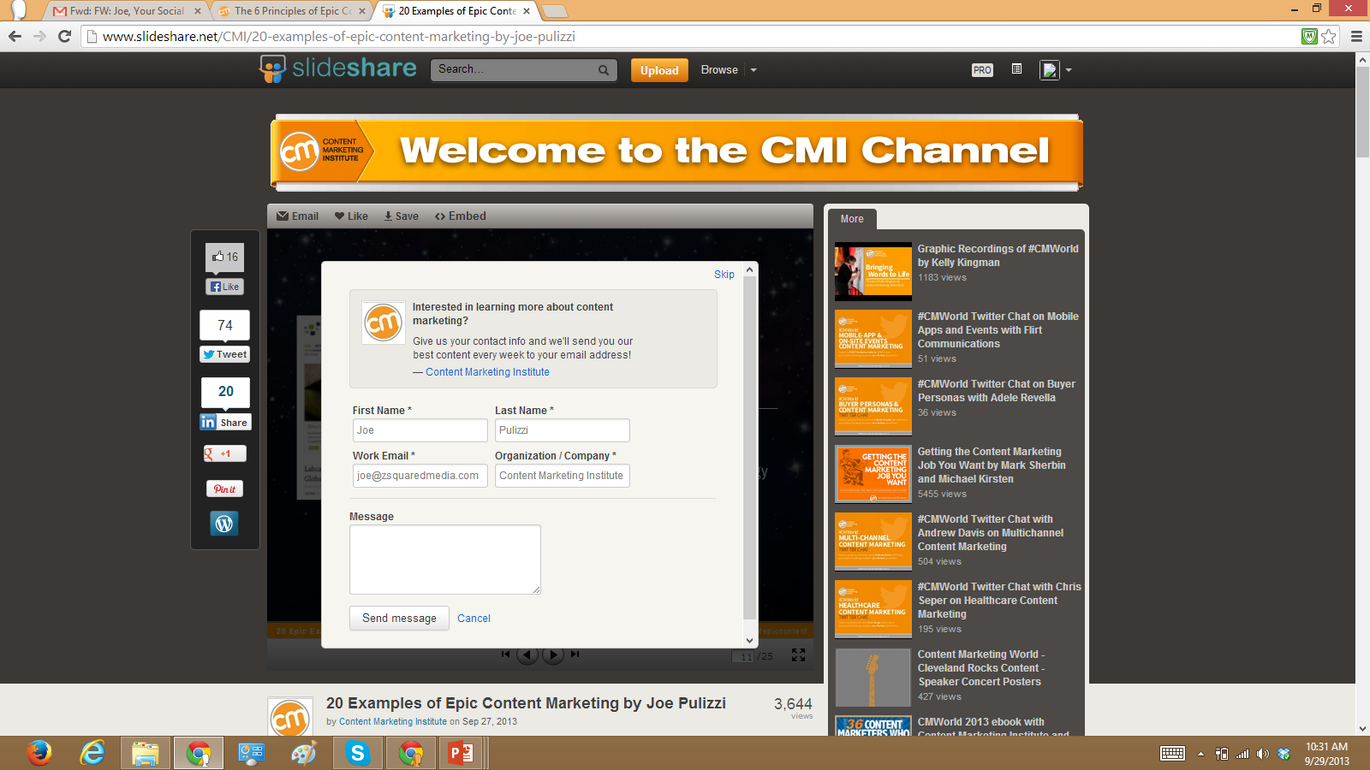

Slide 64
ROI
Notes:
And let’s start by discussing how we help buyers make better purchasing decisions. Because before we can truly understand what we do for vendors like you, it’s critical to understand what we do for the buyer community.
64

Slide 65
Return on Objective
Is the content driving sales?
Is the content saving costs?
Is the content making our customers happier, thus helping with retention?

Slide 66
2014 Resolutions
Watch Content 2020
Create a Content Marketing Mission Statement
Create a Subscription Strategy
Leverage SlideShare
Start Partnering with Influencers
Use Social Media 4-1-1
Know the Business Objective
Consider Buying a Small Media Company
Answer Your Customers’ Questions Publicly
Tell a Different Story!

Slide 67
THANK YOU
Joe Pulizzi
joe@contentinstitute.com • @JoePulizzi on Twitter

